Slide 1
Week 3 Recitation
BIOCHEM 5722
The Harmonic Oscillator

Slide 2
Objectives
Work through the recitation questions on Carmen.
Introduce concepts relevant to the practice problems.

Slide 3

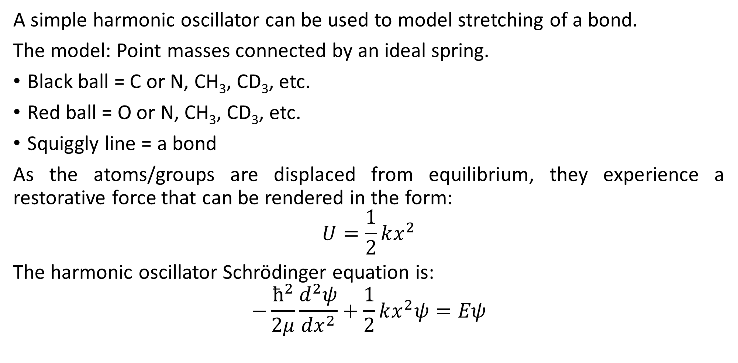
What is a harmonic oscillator?
A simple harmonic oscillator can be used to model stretching of a bond.
The model: Point masses connected by an ideal spring.
Black ball = C or N, CH₃, CD₃, etc.
Red ball = O or N, CH₃, CD₃, etc.
Squiggly line = a bond
As the atoms/groups are displaced from equilibrium, they experience a restorative force that can be rendered in the form:
$$U=\frac{1}{2}kx^{2}$$
The harmonic oscillator Schrödinger equation is:
$$−\frac{ħ^{2}}{2μ}\frac{d^{2}ψ}{{dx}^{2}}+\frac{1}{2}kx^{2}ψ=Eψ$$

Slide 4
Questions?

Slide 5
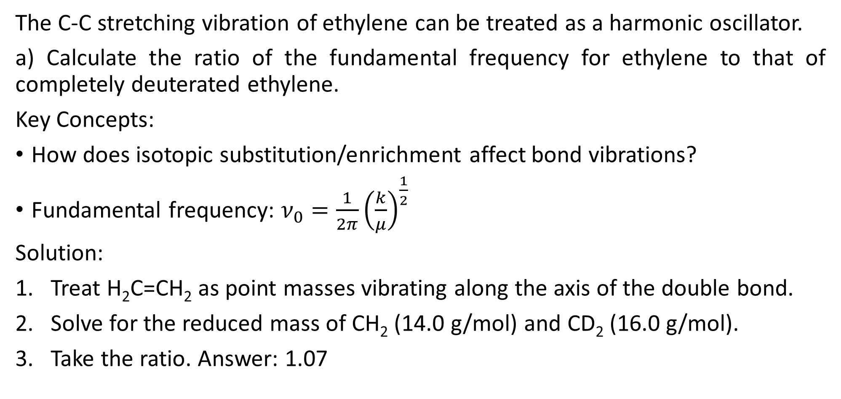
Q1
The C-C stretching vibration of ethylene can be treated as a harmonic oscillator.
a) Calculate the ratio of the fundamental frequency for ethylene to that of completely deuterated ethylene.
Key Concepts:
How does isotopic substitution/enrichment affect bond vibrations?
Fundamental frequency: $ν_{0}=\frac{1}{2π}{\left(\frac{k}{μ}\right)}^{\frac{1}{2}}$
Solution:
Treat H₂C=CH₂ as point masses vibrating along the axis of the double bond.
Solve for the reduced mass of CH₂ (14.0 g/mol) and CD₂ (16.0 g/mol).
Take the ratio. Answer: 1.07

Slide 6
Q1 cont.
b) Putting different substituents on the ethylene can make the C-C bond longer or shorter. For a shorter C-C bond, will the vibration frequency increase or decrease relative to ethylene? Why?
Solution:
Concept Check: What are the units of the force constant?
Concept Check: What is the relationship between force and energy?
Concept Check: Is a shorter bond stronger or weaker than a longer bond?
Beginning from the final concept check, connect the dots until you can adequately answer the question.
Solution: Shorter bonds have a larger force constant. The fundamental frequency is proportional to the square root of k; therefore, the frequency would increase relative to ethylene.

Slide 7
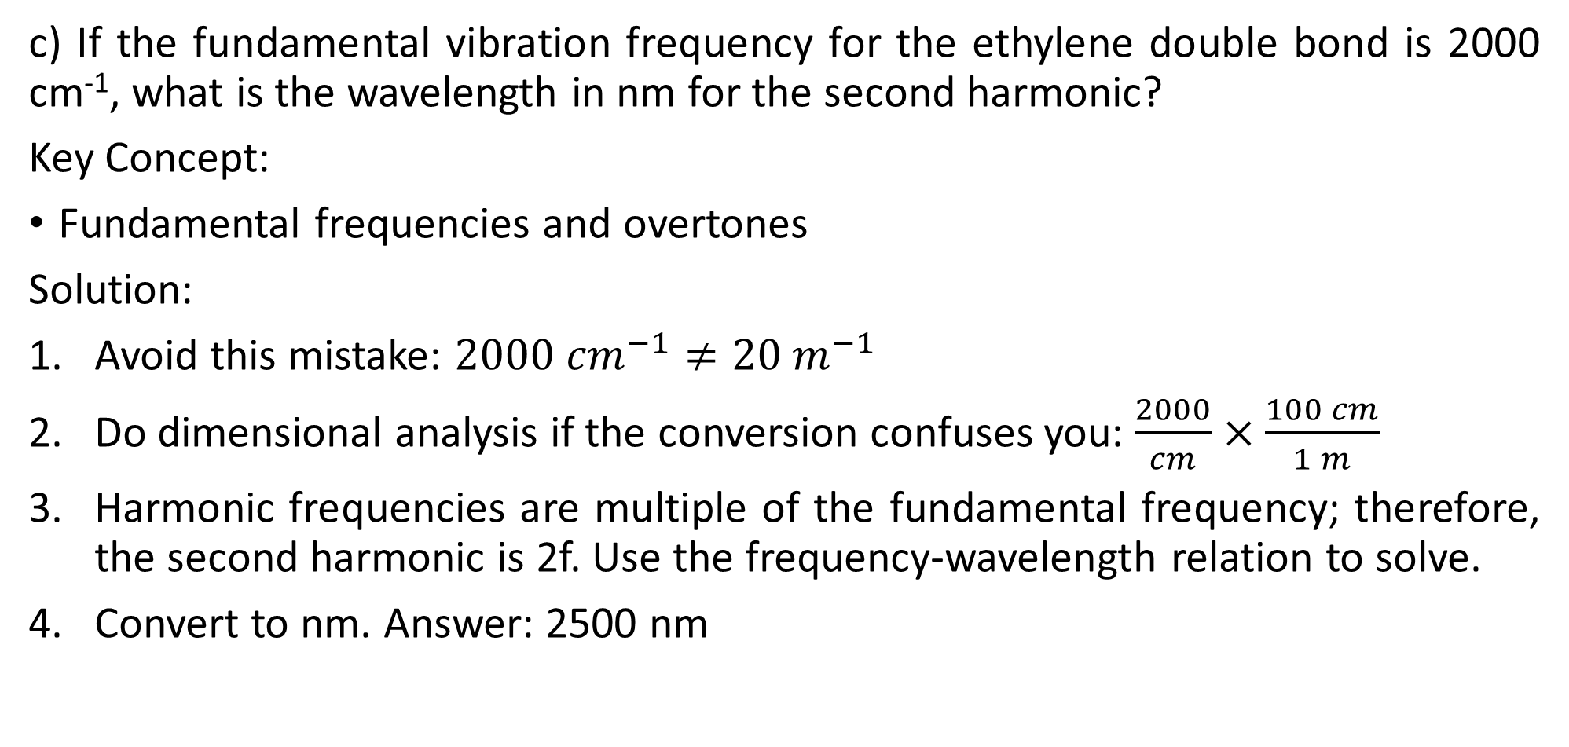
Q1 cont.
c) If the fundamental vibration frequency for the ethylene double bond is 2000 cm⁻¹, what is the wavelength in nm for the second harmonic?
Key Concept:
Fundamental frequencies and overtones
Solution:
Avoid this mistake: $2000 {cm}^{−1}≠20 m^{−1}$
Do dimensional analysis if the conversion confuses you: $\frac{2000}{cm}×\frac{100 cm}{1 m}$
Harmonic frequencies are multiple of the fundamental frequency; therefore, the second harmonic is 2f. Use the frequency-wavelength relation to solve.
Convert to nm. Answer: 2500 nm

Slide 8
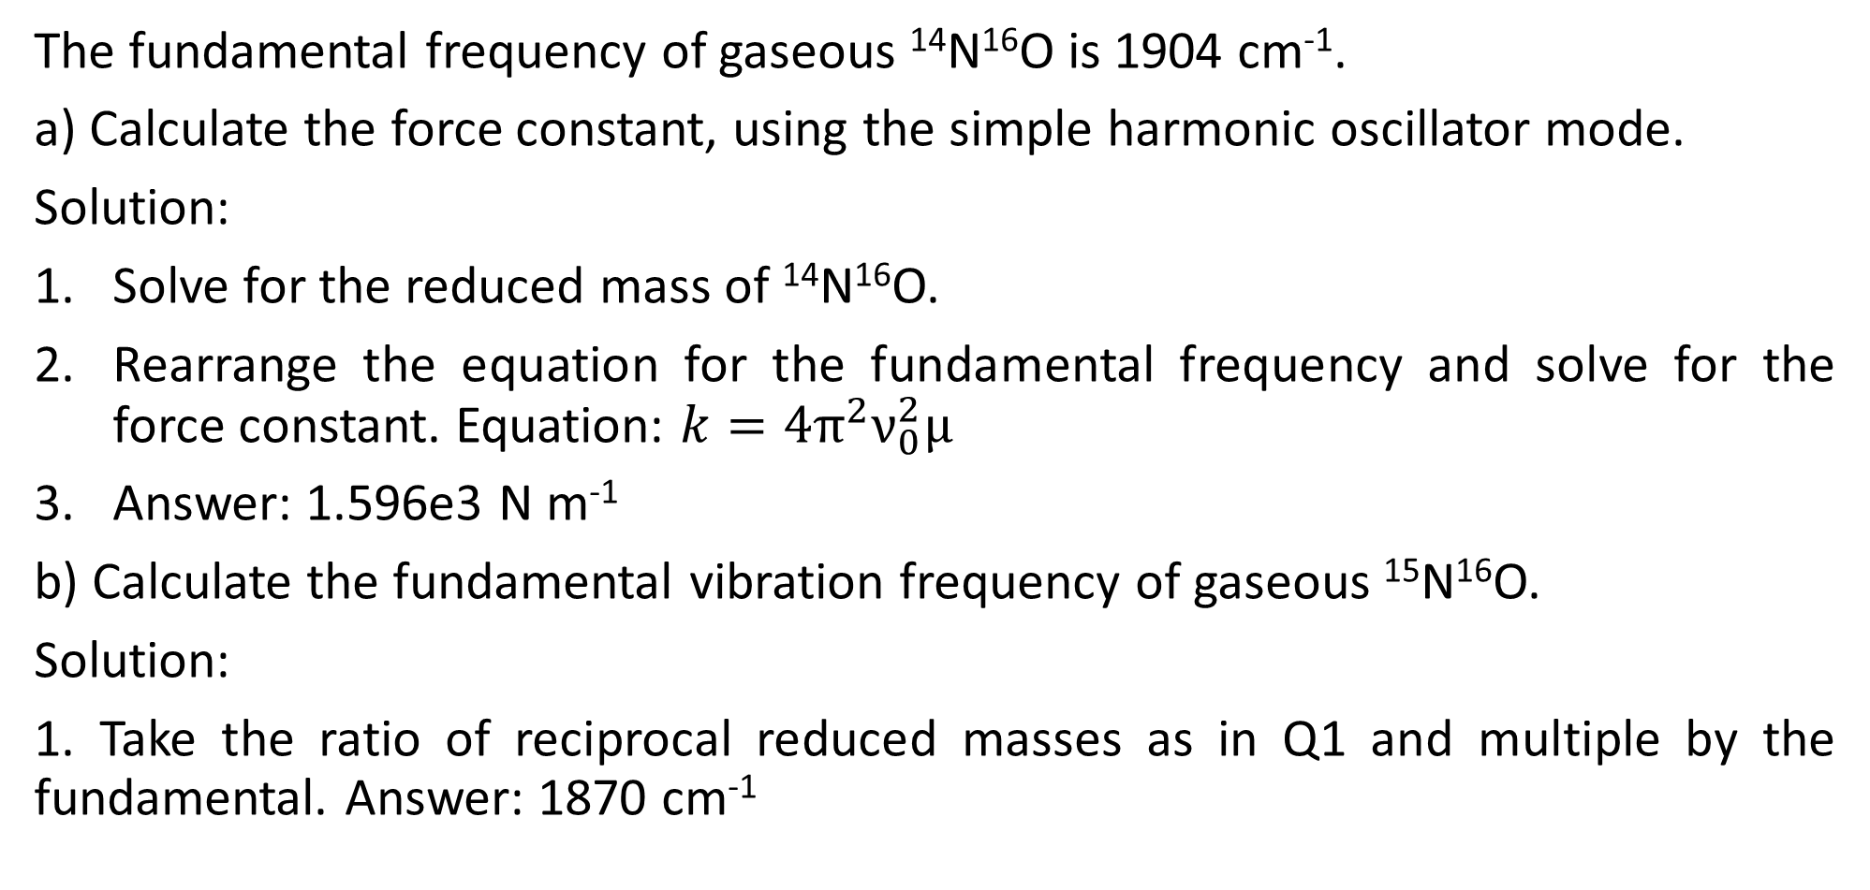
Q2
The fundamental frequency of gaseous ¹⁴N¹⁶O is 1904 cm⁻¹.
a) Calculate the force constant, using the simple harmonic oscillator mode.
Solution:
Solve for the reduced mass of ¹⁴N¹⁶O.
Rearrange the equation for the fundamental frequency and solve for the force constant. Equation: $k=4π^{2}ν_{0}^{2}μ$
Answer: 1.596e3 N m⁻¹
b) Calculate the fundamental vibration frequency of gaseous ¹⁵N¹⁶O.
Solution:
1. Take the ratio of reciprocal reduced masses as in Q1 and multiple by the fundamental. Answer: 1870 cm⁻¹

Slide 9
Questions?
Have a good weekend!

